Slide 1
CS7002 Data Communications
The NEBULA Future Internet Architecture
Yueming Zheng
yzheng@tcd.ie

Slide 2
Overview
What is Nebula Future Internet Architecture
Why we need Nebula?
Three attributes of Nebula
Packets transmission under Nebula architecture
Evaluate Nebula’s performance on data computing
Summary
Notes:
We will go through these points:
Introduce what is nebula, compare nebula with today’s network, introduce three attributes of nebula, analyse packet transmission example under nebula architecture, evaluate nebula’s performance on data computing, and summary

Slide 3
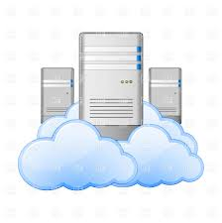





Motivation/Problem
Closed-loop control of blood glucose level for an insulin-dependent diabetic
Record and analyze data
Medical problem ?
Notes:
Before I launch into this architecture, let’s start with a story.
One of the major challenges today is managing our own personal health.
1.We assume we already have sensors, data repositories, camera, exercise monitor, and interactive components could input our data to the cloud --- such as food what we eat, exercise what we take, and other health data.
2. Data center will record, analyze these data with historical data and data from other data sources, and detect anomalies
3. Anomalies will be send to specialists to ensure whether there is medical problems or not.
Everything looks perfect. Have u thought of this process. what is missing from this story?

Slide 4



Motivation/Problem
Closed-loop control of blood glucose level for an insulin-dependent diabetic
Personal healthcare data lost ?
Incorrect dosages ?
Network limited availability ?
Notes:
Health info is confidential. What will happen if they lost?
Dosage is important. In the transmission process, if there is data modification or destruction… cause incorrect dosage…the result will be harmful.
All of these are on the network. If the system fail or be attacked, everything will shutdown.
So we set requirements about the system.
We need strict confidentiality requirements to keep data privacy and secutiry. We need integrity requirements in the data transmission. And we need a high available network.
Okay, maybe u will think.. Can today’s network meet these requirements?

Slide 5
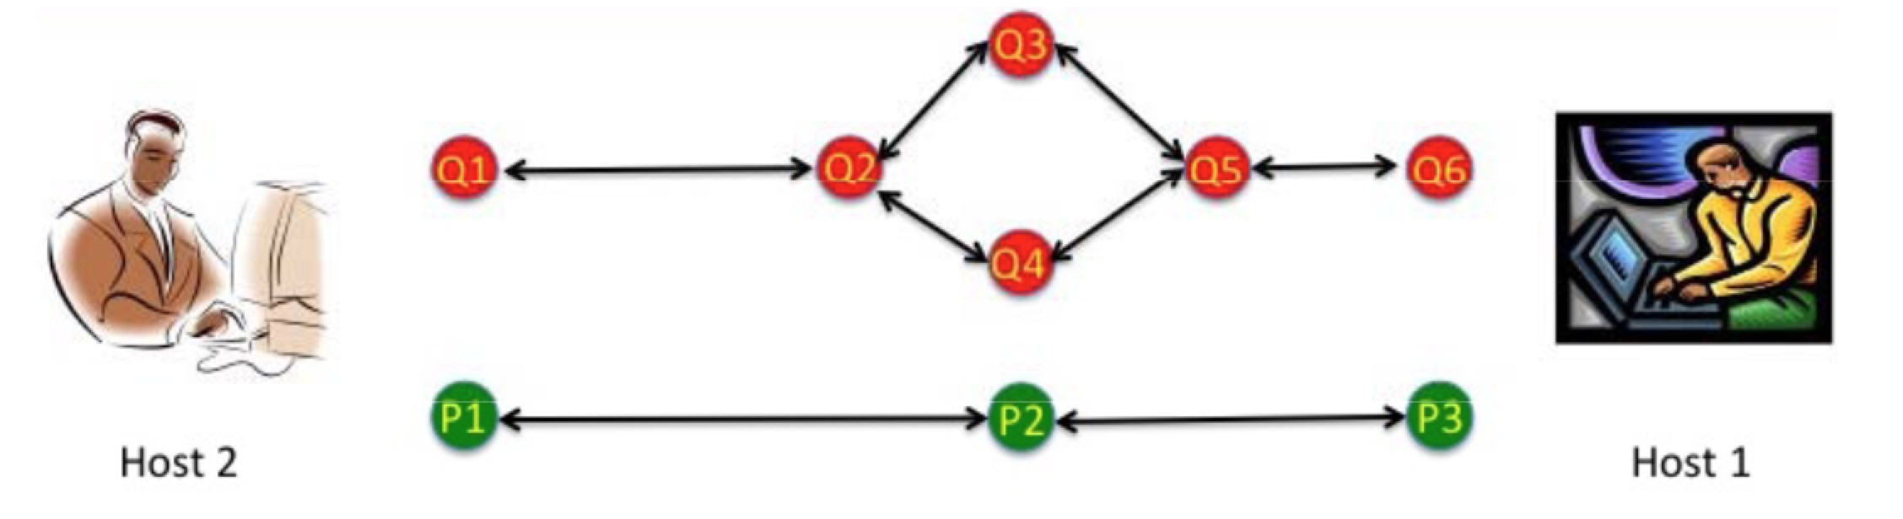
Contrast against Existing Approaches
Today’s network
Using routing algorithm to find single best path
Best-effort policy
Dynamic decisions
Evolution occurs at the end-points (hosts), rather than in the network
Notes:
We compare today’s network with nebula.
Today’s network uses routing algorithm to find the single best path between two endpoints. Routers uses a best-effort policy to send packet. And routers make dynamic decisions, it means unreliable links and routers can exist. And the key point is evolution occurs at the end-points, rather than in the network.
In the graph, there are 9 routers and 2 endpoints. The red routers are more complex. In this network, diagnosis and policy enforcement have to be performed at the endpoints.
But according to Moore’s Law, endpoints cannot hold so much evolutions with increasing computing and performance requirements

Slide 6
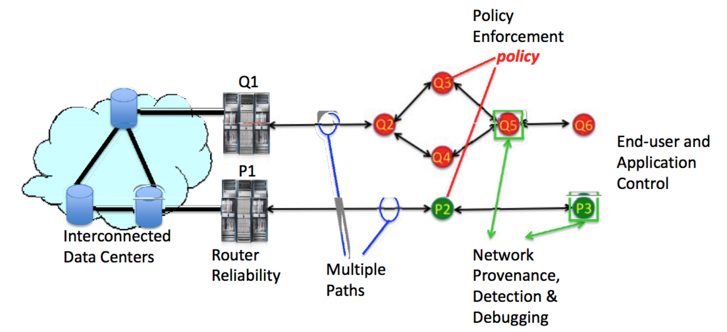
Contrast against Existing Approaches
Nebula’s network
Routers are more reliable
Path diversity for resilience
New fault-tolerant control software
Examining solutions on policy and economics
Notes:
This is nebula’ s network.
First, data center networks and their interconnection are different from the conventional internet.
Second, the routers are more reliable, so the failure on the interconnection will be reduced.
Also, nebula exploit path diversity for resilience and new fault-tolerant control software to detect failures.
In addition, nebula exam implications of resilience solutions on policy and economics.
In this graph, if any router fails, the packet will chose other usable path. If q1,p1 fail, they will be preserved by each other. For policy enforcement, if q3 and q4 is incompatible, we can only use one of them.
In nebula, problems can be found and repaired quickly (because of network provenance, failure detection, network debugging)

Slide 7
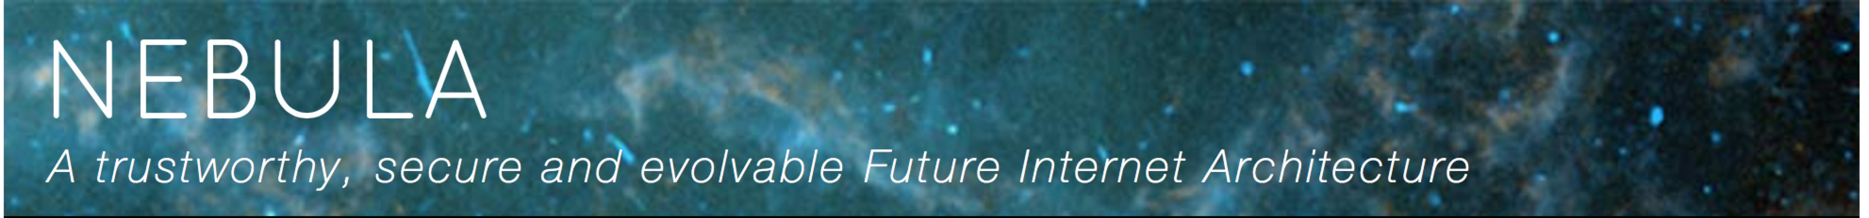
Description of Approach
Enter “NEBULA”…
NEBULA Future Internet Architecture (FIA) project is focused on clouding computing based on a future network.
Three attributes:
comprehensive
completely new
large team with a diversity of skill sets and approaches to sub-problems
Notes:
Now, u already have a basic understanding of nebula. Let’s talk more details.
If u enter nebula on the google website, u will find this sentence.
Nebula has three attributes :
First, the architecture is comprehensive, it ia about very complex and difficult problems. Second, the approach is completely new, in many aspects it could not be extended. Third, the architecture need a large team with a diversity of skill sets and approaches to sub-problems.

Slide 8
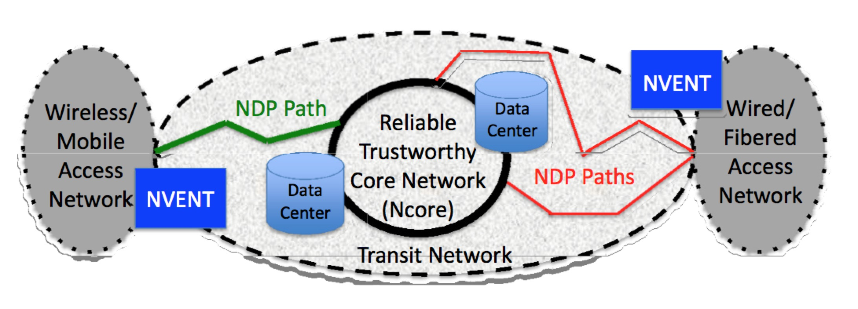
Nebula
Three components:
Ncore: Nebula Core network
NVENT: Nebula Virtual & Extensible Networking Techniques
NDP: Nebula Data Plane
Notes:
This is nebula architecture.

Slide 9
Nebula Core Architecture
NCore
High performance core routers
Richer interconnection topologies -> data center attachment and NCore router interconnection
Fault tolerance -> high reliability
Loading balance -> Ultra-reliable routers
Problems can be diagnosed and repaired during runtime
Notes:
What is Ncore?
NCore is based on a model of high-performance core routers. It offers richer interconnection to the data center.
Ncore uses distributed systems fault tolerance idea to achieve high reliability.
Ncore also offer a loading balance between ultra-reliable router architectures and ultra-reliable routers

Slide 10
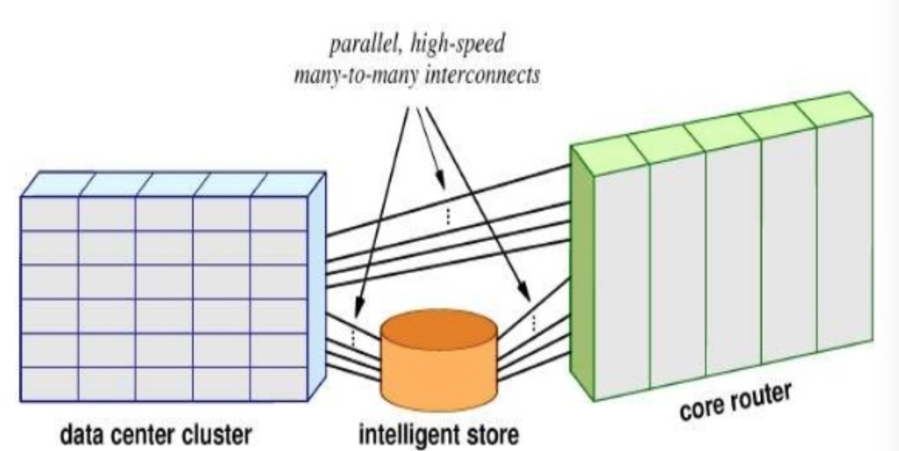
Nebula Core Architecture
Connects data center to each other
The NEBULA Core (NCore) redundantly interconnects enterprise data centers containing replicated data with ultra-high availability, next-generation core routers developed in collaboration with Cisco.
Notes:
NCore is to connects data center to each other

Slide 11

Nebula Data Plane
NDP
Resilient access
Path verification mechanism -> ICING
Proof of Consent (PoC)
authorized?
Proof of Provenance (PoP)
authorized path is followed?
Notes:
What is NDP?
NDP include new data-plane technologies for resilient access, allowing communication only when all involved parties, such as endpoints and transit networks, have agreed to participate (this is desirable for reasons of condifdentiality, integrity and availability).
And the key point is path verfication mechanism, named ICING. It has two parts: Proof of Consent and Proof of Provenance. Proof of Consent is to check whether the path is authorized. Proof of Provenance is to check whether the authorized path is followed.

Slide 12
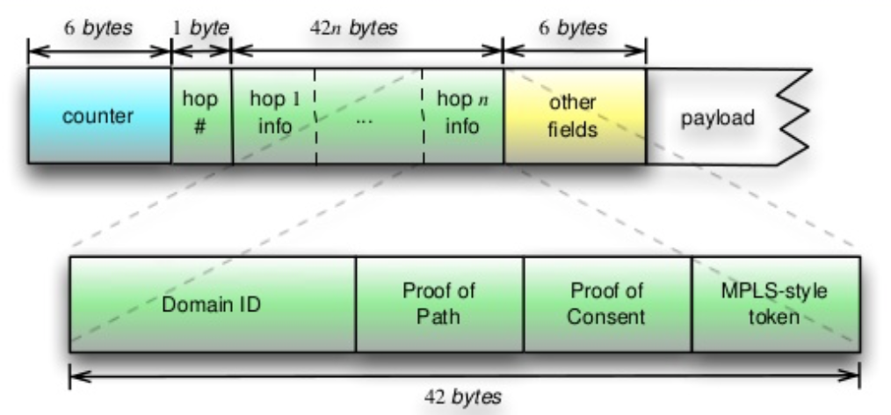
Nebula Data Plane
Connects data center to the access (edge) networks
Notes:
NDP is to connects the data center to the access (edge) networks. This is the NDP packet. We set specific areas for Proof of Consent and Proof of Provenance.

Slide 13
Nebula Data Plane
Connects data center to the access (edge) networks
Map path consent and path compliance to cryptographic tokens:
PoC: Proof of Consent
PoP: Proof of Path
As the packet traverses the path, it is incrementally marked with PoP
Improve security:
✔ Authorized and strong cryptographic
✖️ Denial-of-service attacks
Notes:
Before packet are sent over any network path, each domain along the path has consented to the use of the path. Domain’s consent is “proof of consent” --- which is in the packet when the packet is launched.
As the packet traversers the path, it is marked with proof of provenance. PoP shows the packet has travelled through each domain and in correct order.

Slide 14
NDP – Path Setup
When the specification is received, the system checks a cache for a cached compliant path to the destination or service
Scenario 1: path is available -> obtain consent to use the path
Scenario 2: nothing is cached / no consent for a cached path-> system would iterate requests for consent to consent servers
Result:
1.establish and cache a path
2.fail with an error
Notes:
If a path is available, try to obtain consent to use the graph, perhaps with cached proofs of consent if obtaining consent is expensive.
If nothing is cached, or there is no consent for a cached path, the system would …

Slide 15
NDP – Naming
Aim: human-readable names -> network-usable information
TorIP (ISP, ID) --- ID identifies a mailbox
ICING --- DNS is augmented by policy enforcement
Example : www. foo . com
PoC1 PoC2
Notes:
NDP also has naming solutions. It maps human-readable names into network-usable information.
In TorIP, a name server resolves a name to a set of (ISP,ID) pairs. ID identifies a mailbox, client can use it to find server.
In ICING, NDS is augmented by policy enforcement, by forcing paths to have consenting elements.
poc are cacheable by clients, so only resolve the most specific name. For example, www.foo.com will get two general Proof of Consent.)

Slide 16
Nebula Virtual and Extensible Network Techniques
NVENT
New control-plane technologies
Policy specifications, policy-based path setup and service naming
Declarative networking
Lets administrators provide high-level specifications of their routing policies, without having to worry about implementation details and getting them right.`
Notes:
NVENT embodies new control-plane techonologies that focus on policy specification, policy-based path setup and service naming.
NVENT uses declarative networking, based on Network Datalog
Declarative Networking:
is a programming methodology that enables developers to concisely specify network protocols and services, which are directly complied to a dataflow framework that executes the specifications.

Slide 17
NVENT – Policy Configuration
Determine:
How a client can ask for certain properties
How ISP offer certain properties
Default policy: drop traffic -> ”deny by default”
General case:
Ask for a policy “HIPAA” -> HIPAA=yes -> policy server’s policy can be queried; a path is constructed from consenting servers
Notes:
There are multiple policies from multiple sources, some applications need path control, some need source reservations, some need failover guarantees. -> these are at API level. NVENT will determine how a client ask for certain properties and how a ISP offer certain propeties.
The dafault policy is to drop traffic, sometimes called “deny by default”.
For instance, a policy indicating HIPAA, the stated as HIPAA=yes. A policy server’s policy can be queried by clients and consent servers; a path is constructed from consenting servers.
(policy logic must know:1. which paths are permitted; 2. which paths are available)

Slide 18
Putting Nebula Together
Phase I
--- router architecture, data center networking , interdomain networking, network control, and network security
Phase II
--- regulatory policy and economics seeking to understand the implications
Notes:
Now, we can start nebula integration
The first phase of Nebula need invention of new approaches and elements, such as …
Then ,it need … including reliable routers and routes chosen, flexible policies.

Slide 19
Putting Nebula Together
Phase | Design Goal | NEBULA
I | Ultra-reliable Future Internet Router Example (FIRE) | Ncore
 | Ultra-reliable data center or ISP network
 | Ultra-reliable Interdomain service | NDP
 | Policy Control | NVENT
II | Economic and Policy Implications
Notes:
Under nebula’s architecture, these goals can be achieved respectively.
Ncore can offer ultra-reliable future internet router to reduce sharing and implementation. The team at the university of Delaware has designed a routerBricks on two high-performance PC with 10 Gbps cards.
Ultra-reliable data center or Internet Service Provider: this data center interconnect to the Ncore routers. It is used to access data and computer cycles in the data center.
Ultra-reliable Interdomain service: this is the primary locus for policy issues, such as security, privacy, fault-tolerance and other complex and specialized policies. It can be covered by NDP.
Policy control: it need to provide a service consistent with cloud network. Because NVENT uses declarative networking, since path information is cacheable, discovery can be asynchronous and path lookup can be very quick.
And nebula also focus on Economic and policy implications

Slide 20
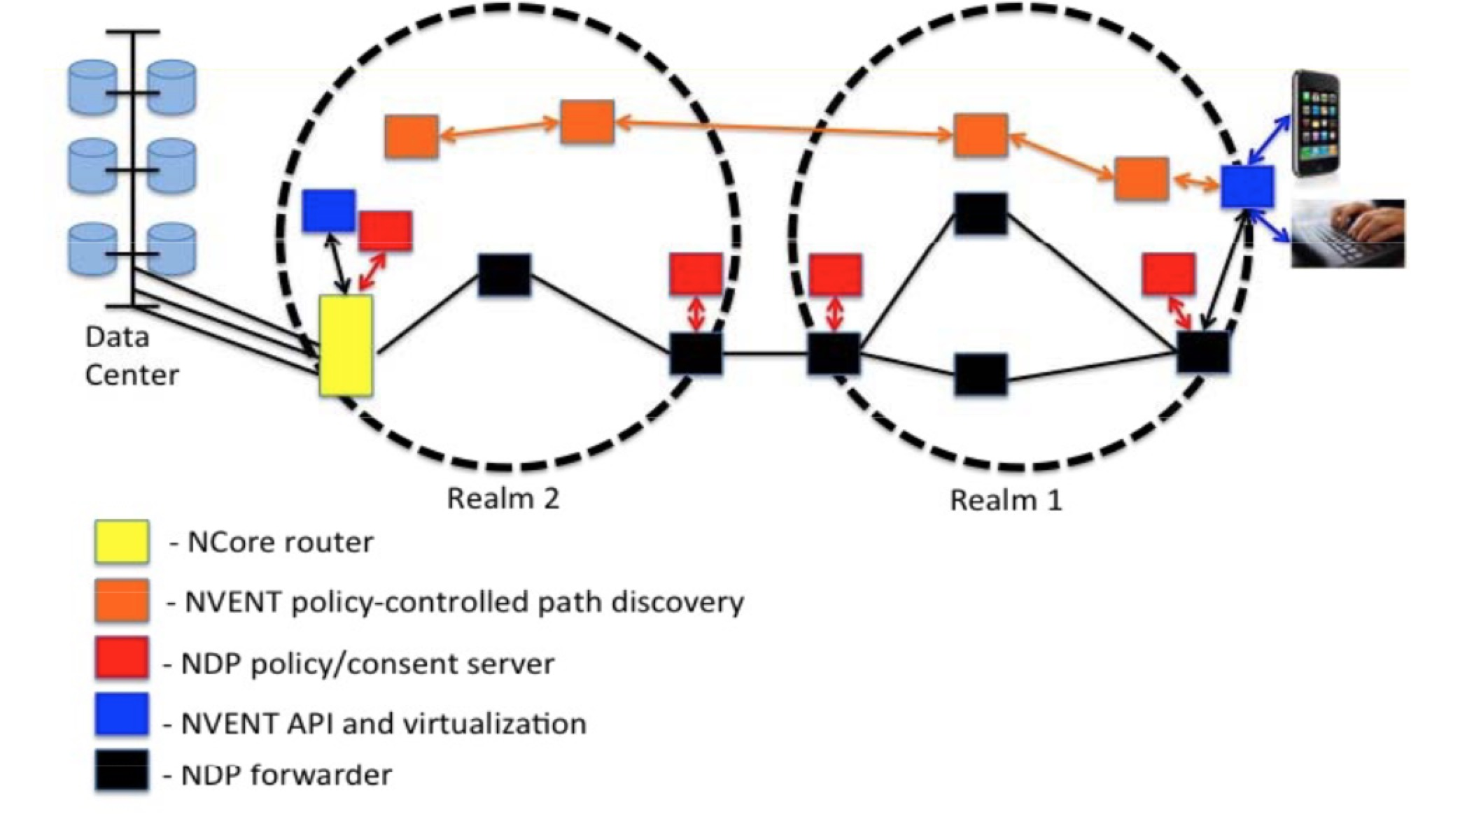
Putting Nebula Together
Sensitive health data example
Notes:
I want to use sensitive health data example to explain this architecture again.
1. Cell phone contacts NVENT & requests a path to NCore
2. NVENT looks for path compiling to the policy and contacts NDP policy server to obtain necessary PoC
3. NVENT returns all the PoC to the cell phone
4. Cell phone uses these PoC to send packets vis NDP to nearest NCore router
5. NCore performs network provenance to verify the path and forwards packets to Data Center

Slide 21
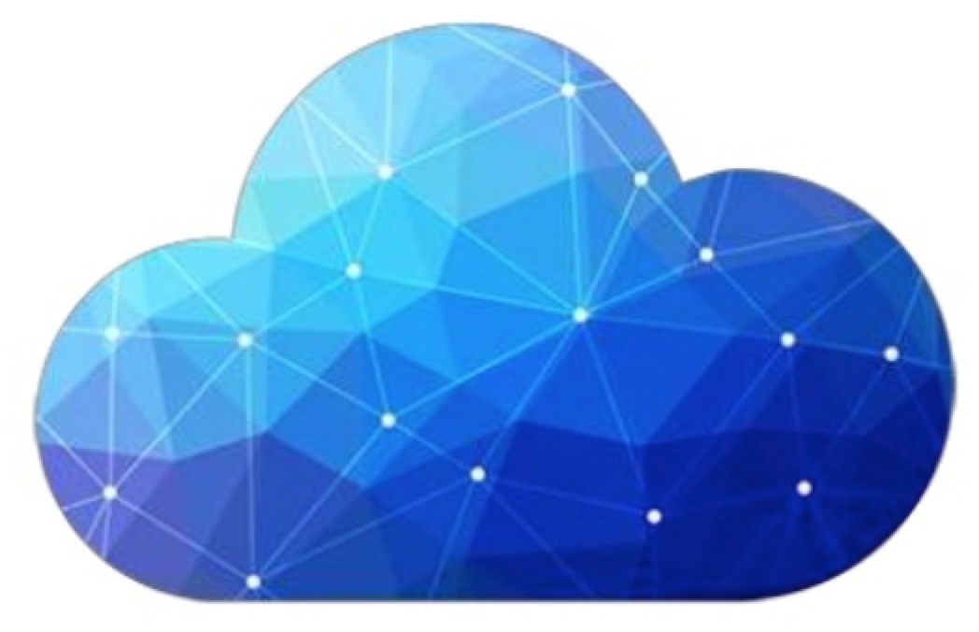
Evaluation
From the experiment in University of Minnesota:
On an emulated volunteer platform that spans over 50 PlanetLab nodes distributed across Europe, and show how a common data-intensive computing framework, MapReduce, can be easily deployed and run on Nebula

Slide 22
Summary
Nebula’s vision: Trustworthy cloud computing
Three components: NCore, NDP, NVENT
Three attributes: comprehensive, completely new, large team
Higher security, reliable, and efficient
Notes:
Although there are some researches to work on, I want to say thank you to nebula’s team, they always try to offer us higher security, more reliable and efficient network.
Because of limited time, I cannot cover more interested areas, such as nodiac schema, the interface between these three components, and so on.
Nebula is a fantastic architecture. Anyway , welcome to nebula’s world!

Slide 23
Reference
[1] Tom Anderson, Ken Birman, Robert Broberg, Matthew Caesar, Douglas Comer, Chase Cotton, Michael J. Freedman, Andreas Haeberlen, Zachary G. Ives, Arvind Krishnamurthy, William Lehr, Boon Thau Loo, David Mazières, Antonio Nicolosi, Jonathan M. Smith, Ion Stoica, Robbert van Renesse, Michael Walfish, Hakim Weatherspoon, and Christopher S. Yoo. The NEBULA Future Internet Architecture, volume 7858 of LNCS. Springer Verlag, 2013.
[2] NEBULA project web page. http://nebula- fia.org/.
[3] Liu, C., Ren, L., Loo, B.T., Mao, Y., Basu, P.: Cologne: A declarative distributed constraint optimization platform. Proc. VLDB Endowm. 5(8), 752–763 (2012)
[4] Ryden M, Oh K, Chandra A, et al. Nebula: Distributed edge cloud for data-intensive computing[M]. 2014.

Slide 24
Reference
[5] Tom Anderson, Ken Birman, Robert Broberg, Matthew Caesar, Douglas Comer, Chase Cotton, Michael J. Freedman, Andreas Haeberlen, Zachary G. Ives, Arvind Krishnamurthy, William Lehr, Boon Thau Loo, David Mazières, Antonio Nicolosi, Jonathan M. Smith, Ion Stoica, Robbert van Renesse, Michael Walfish, Hakim Weatherspoon, and Christopher S. Yoo. A Brief Overview of the NEBULA Future Internet Archite cture; NEBULA – A Future Internet That Supports Trustworthy Cloud Computing, 2014
[6] Loo, Boon Thau, and W. Zhou. "Declarative Networking." Morgan & Claypool, 2012:87-95.

Slide 25
Questions ?

Slide 26
Thank You

